Slide 1
Machine Learning in Practice
Lesson 19.2

Slide 2
Class Objectives
By the end of this lesson, you will be able to:
Segment data.
Prepare data for complex algorithms.
Explain the importance of preprocessing data for unsupervised learning.
Transform categorical variables into a numerical representation by using Pandas.
Scale data by using the StandardScaler module from scikit-learn.

Slide 3
Notes:
1. Instructor Do: Welcome the Class (10 minutes

Slide 5
Recap
In the previous lesson, you learned:
How to recognize the differences between supervised and unsupervised machine learning.
What clustering is and how to use it in data science.
How to apply the K-means algorithm to identify clusters in several datasets.
How to determine the optimal number of clusters for a dataset by using the elbow method.

Slide 6
How is machine learning used in data analytics?

Slide 7
Machine Learning in Data
Examples include:
Finding outliers
Classifying fraudulent credit card charges
Predicting customer preferences
Algorithmic trading

Slide 8
What is the difference between unsupervised and supervised learning?

Slide 9

Supervised Learning vs. Unsupervised Learning Unsupervised Learning
The main distinction between the two approaches is the use of labeled datasets.
Supervised Learning
Unsupervised Learning
Uses labeled input and output data.
Only has labeled input data.
vs.
x₂
x₂
x₁
x₁

Slide 10
The K-Means Algorithm

Slide 12
Activity: Warm-Up
In this activity, you will review some K-means concepts and code from the previous class.
15 Minutes
Notes:
2. Student Do: Warm-Up (15 minutes)

Slide 15
Review Warm-up
Notes:
3. Instructor Do: Review Warm Up (10 minutes)

Slide 17
Scaling Data

Slide 18
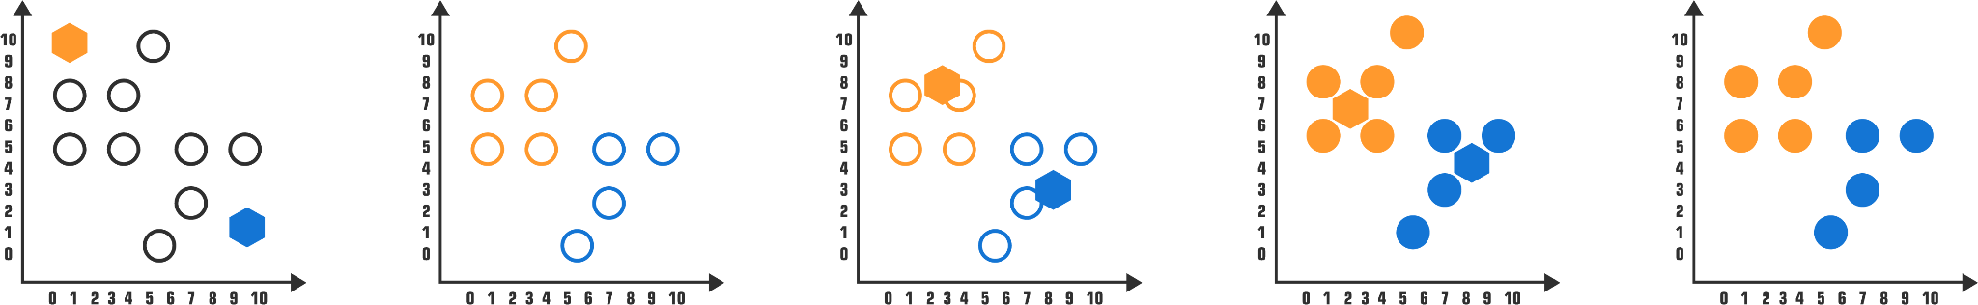
Scaling Data with StandardScaler
We can optimize data clustering by selecting the best value for k. The K-means algorithm is useful for grouping and understanding data.
Randomly select K-clusters
Each object assigned to similar centroid randomly
Clusters centers updated depending on renewed cluster mean
Re-assign data points; update cluster centers
Re-assign data points

Slide 19
We can often enhance and optimize machine learning algorithms by applying Principal Component Analysis, or PCA.

Slide 20
Principal Component Analysis (PCA) is a statistical technique for streamlining the machine learning process when too many factors exist in the data.

Slide 21
Principal Component Analysis (PCA)
PCA reduces the number of factors by transforming a large set of features into a smaller one that contains MOST of the information of the original larger dataset.
PCA 1st dimension
PCA 2nd dimension
pc2
pc 1

Slide 22

Principal Component Analysis (PCA)
PCA is a dimensionality-reduction method that:
Looks at all the dimensions (or data columns) in a dataset.
Analyzes the weight of their contribution to the variance in the dataset.
Reduces the dimensions to a smaller set that still contains as much of the information (the maximum variance) of the original dataset as possible.
PCA will NOT capture all the information from the original dataset, but it will capture as much as possible to maintain the predictive power and the meaning of the original dimensions.

Slide 23
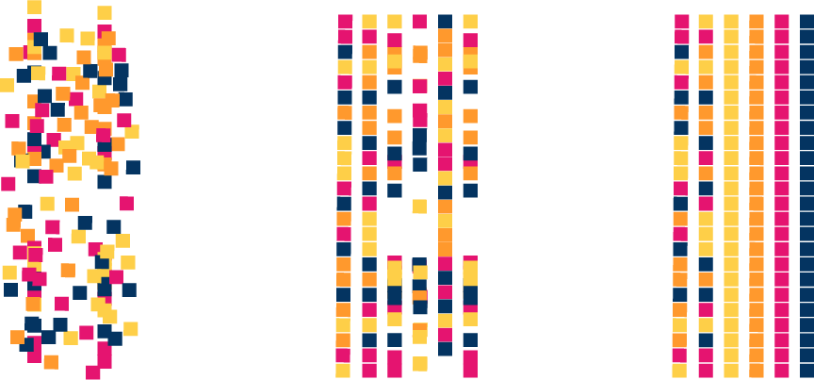
Principal Component Analysis (PCA)
Reducing the number of factors, or dimensional reduction, comes at the expense of some accuracy, but the goal is to trade a little accuracy for simplicity.
Notes:
shutterstock_398469061

Slide 24
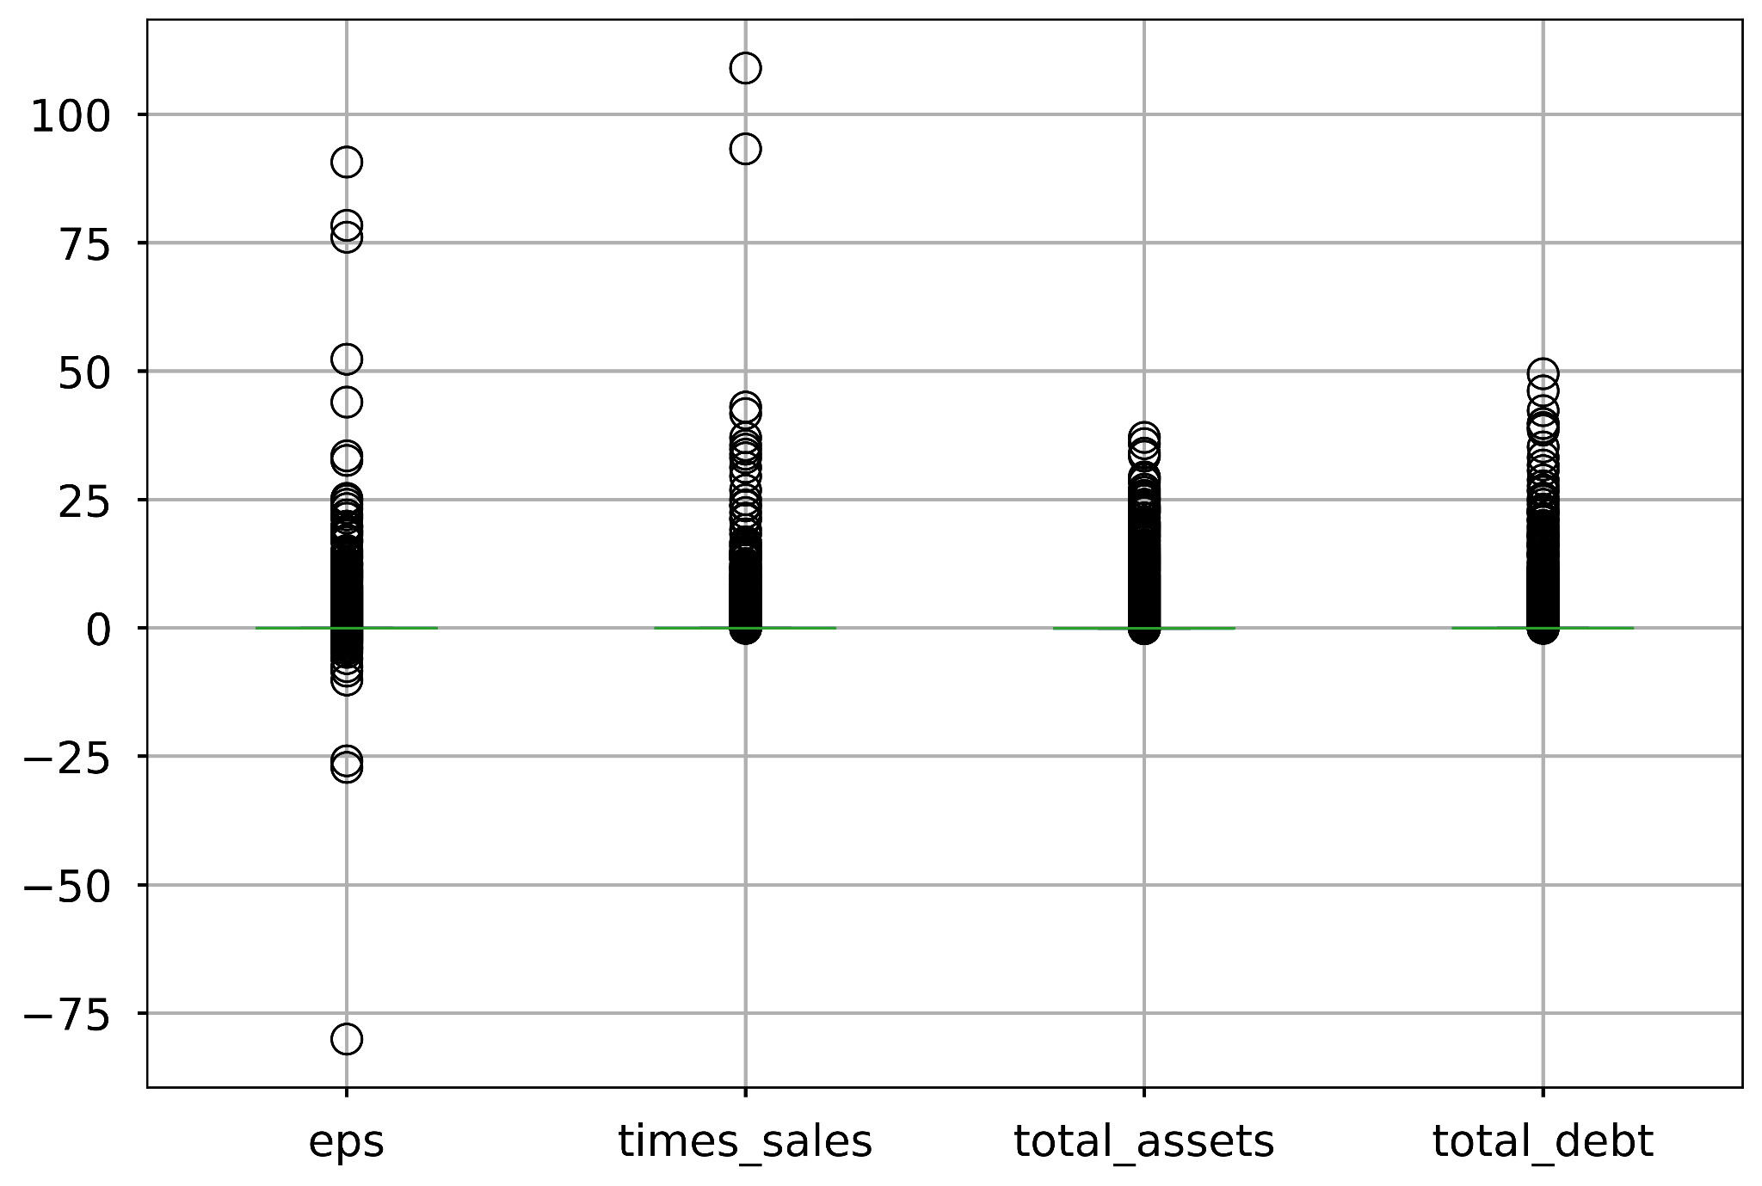
Standard Scaling
Before
After
Before using PCA, we'll apply standard scaling to learn how to transform the features of data.
After scaling, we’ll combine PCA with the K-means algorithm. This will give us a strategy to better handle extremely large datasets.

Slide 25


This Week’s Challenge Assignment
You’ll manage data and optimize the clusters with PCA, and then analyze the results. Next, you’ll propose the best number of cryptocurrency clusters for the portfolio.

Slide 26


Scaling Data
Manual preparation of data can be time-consuming. This is especially true if we have several columns in a DataFrame to transform.
vs.
Notes:
shutterstock_1140576245

Slide 27
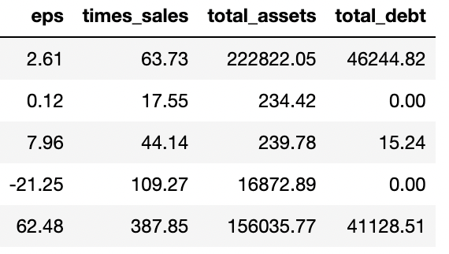
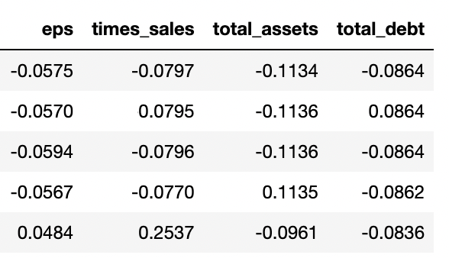
Scaling Data
Remember, the K-means algorithm requires all the columns in a DataFrame to have numeric values.
We should also ensure that the numeric values have the same scale.
This prevents K-means from putting too much weight on any single variable.
Numeric Data Before Scaling
The Same Data After Scaling

Slide 28

Scaling Data
When we scale data, we eliminate the measurement units and scale the numeric values to a similar scale.
We can then compare data of differing natures.
Notes:
shutterstock_202139719

Slide 29


Scaling Data
Instead of manually transforming our data, we can use functions from Pandas and the scikit-learn library to simplify our data preparation.

Slide 30
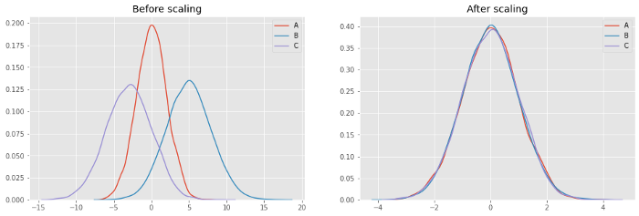
Scaling Data
The most common way to scale data is to apply standard scaling, which is a method of centering values around the mean.
x – 𝜇
z =
𝜎
𝜇 = Mean
𝜎 = Standard deviation
https://towardsdatascience.com

Slide 31
Scaling Data
Data standardization is a common practice in the data preprocessing steps that occur before training a machine learning model.
Actual data
After scaling
After standardization
1
1
https://becominghuman.ai

Slide 32
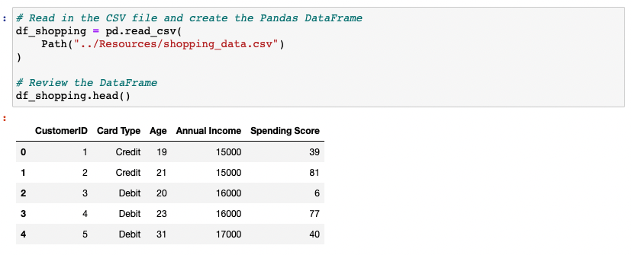
Scaling Data
Let’s review one of our credit card spending datasets to illustrate how standard scaling works.

Slide 33
Applying Standard Scaling

Slide 35
Preprocessing Data

Slide 36
an important aspect of machine learning is data preparation, or data preprocessing.

Slide 37

Preprocessing Data
We can import a dataset into a Pandas DataFrames, but that doesn't mean all the data is ready for immediate analysis by a machine learning model.
Notes:
shutterstock_1089582068

Slide 38
Preprocessing Data
We should consider the following factors when feeding data to a machine learning model:
01
02
03
Most machine learning models cannot directly work with data that is in the form of strings or text.
We must encode, or convert, these elements into numeric categories.
Machine learning algorithms have trouble learning about data with wildly different scales.
Missing values are difficult for machine learning models to navigate.

Slide 39


Preprocessing Data
There is a saying, “Garbage in, garbage out.”
The data going into a machine learning model must be clean for the predictions coming out of it to be accurate.
Notes:
shutterstock_1669187632

Slide 40
Encoding is a preprocessing technique for creating a numeric representation of a categorical variable.

Slide 41
Preprocessing Data
20 minutes
Notes:
5. Everyone Do: Preprocessing Data (20 minutes)

Slide 43
Notes:
6. Break (15 minutes)

Slide 44
Activity: Standardizing Stock Data
In this activity, you will use the K-means algorithm to segment customer data for mobile versus in-person banking service ratings.
25 Minutes
Notes:
7. Student Do: Standardizing Stock Data (25 minutes)

Slide 45
Notes:
8. Instructor Do: Review Standardizing Stock Data (15 minutes)

Slide 47
Clustering Complex Data
Notes:
9. Instructor Do: Clustering Complex Data (20 minutes)

Slide 48
Clustering Complex Data
Sometimes, complex or unusual datasets might require alternative algorithms for clustering.
In this demonstration, we’ll introduce two:
01
Birch
02
Agglomerative clustering

Slide 49
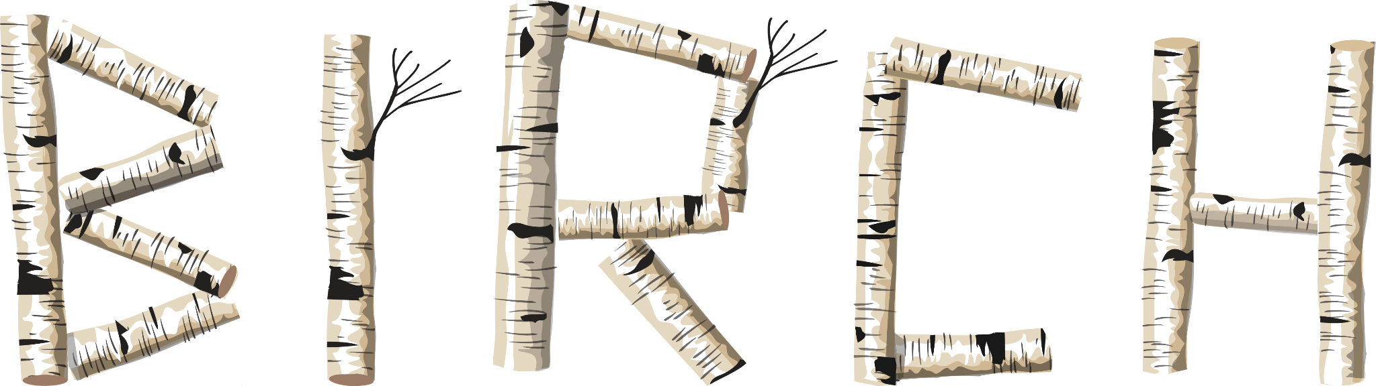
Clustering Complex Data: BIRCH
BIRCH stands for:
Balanced
Iterative
Reducing
and
Clustering
using
Hierarchies
Notes:
shutterstock_1551264395

Slide 50

Clustering Complex Data: BIRCH
BIRCH is an unsupervised data mining algorithm that is similar to K-means, with a few differences.
Data
Phase 1:
Load data into memory by building a CF tree
In particular, BIRCH uses hierarchical clustering.
This approach may start out with many clusters, but then over the process of learning, BIRCH combines these clusters until there is only the specified number left.
The inventors of BIRCH designed it for use with extremely large datasets. This is still its main purpose because it tends to be memory-efficient.
Initial CF tree
Phase 2:
Condense data by building a smaller CF tree (optional)
Smaller CF tree
Phase 3:
Global clustering
Good cluster
Phase 4:
Cluster refinement (optional)
Better cluster
https://www.engati.com

Slide 51
Clustering Complex Data: Agglomerative Clustering
Agglomerative clustering is like BIRCH.
Neither one requires you to specify the appropriate cluster count k, unlike K-means.
While you can specify a specific cluster count with these two approaches, they are flexible enough to divide the data into categories without much input from you.
Sometimes there isn’t a single, catch-all answer when deciding to use one clustering routine over another.
Instead, data scientists often try multiple algorithms to find out which one appears to work best on their specific data.
Agglomerative
Divisive

Slide 52
We’ll try out all three clustering methods (K-means, BIRCH, Agglomerative) on a single dataset and preview the resulting labels.

Slide 53
Compare and Contrast Alternative Clustering Algorithms

Slide 55
Activity: Segmenting Customer Data
In this activity, you will use BIRCH, agglomerative clustering, and the K-Means model to segment a dataset on thousands of consumer credit card holders, courtesy of a Kaggle competition.
25 Minutes
Notes:
10. Student Do: Segmenting Customer Data (25 minutes)

Slide 56
Notes:
11. Instructor Do: Review Segmenting Customer Data (15 minutes)

